Slide 1
Block Thresholding Wavelets on Graphs
Tech Talk for Oper 601
Capt Jeff Williams
03 Jun 2021

Slide 2
Contents
1: Introduction
2: Literature Review
3: Methodology
4: Results
5: Conclusion
6: References

Slide 3
1: Introduction
Wavelet analysis, a popular signal processing tool, has many attractive properties such as smoothing, spatial adaptivity and computational efficiency. Many quickly apply the wavelet transform to their research without conducting a full wavelet analysis. One of these overlooked areas is wavelet thresholding, removing noisy data, magnifies attractive wavelet properties across countless applications of the wavelet transform. This research introduces a wavelet thresholding technique which groups similar graph wavelet coefficients together and removes the noisy blocks to improve the desired effect of the graph wavelet analysis.

Slide 4
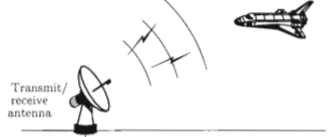
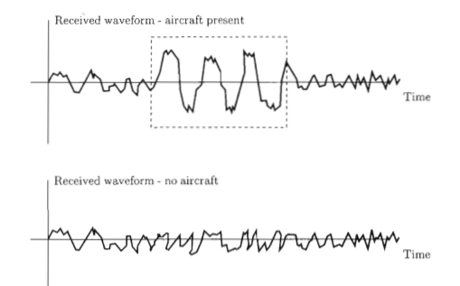
2: Signal Processing
S.M Kay (1993) Signal Processing (SP): analysis, interpretation and
manipulation of signals
Radar (see aircraft example)
Communications
Speech
Sonar
Image Processing
Biomedicine
Control
Seismology
Wavelet analysis is a
popular SP tool

Slide 5
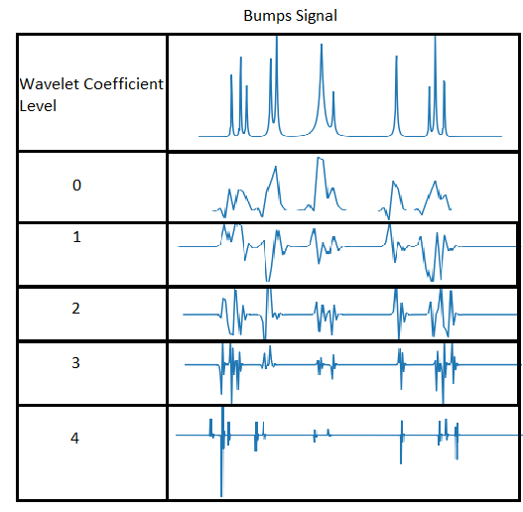

2: Wavelets and Thresholding
Wavelet analysis transforms signals into coefficients
through expansions and dilations of specially designed
functions, wavelets.
“The wavelet transform is a tool that cuts up data or functions or operators into different frequency components, and then studies each component with a resolution matched to its scale” – Ingrid Daubechies
c
d

Slide 6
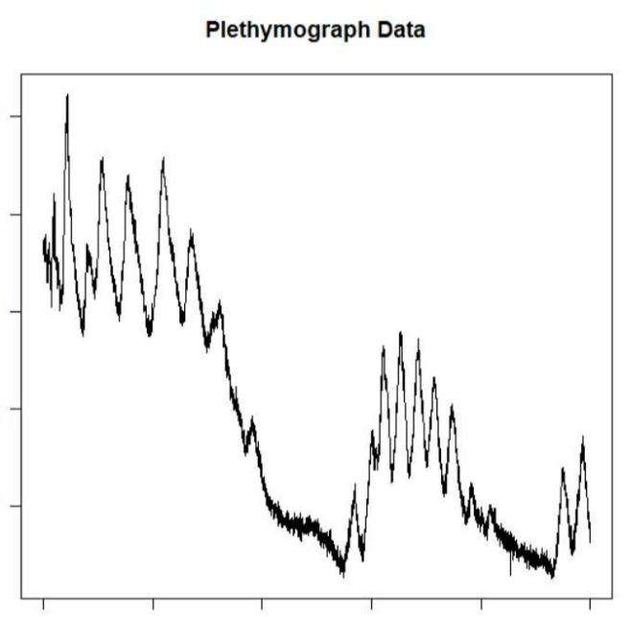
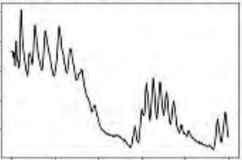

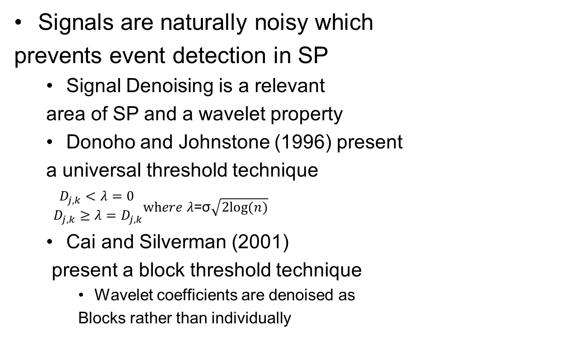
2: Wavelets and Thresholding
Signals are naturally noisy which
prevents event detection in SP
Signal Denoising is a relevant
area of SP and a wavelet property
Donoho and Johnstone (1996) present
a universal threshold technique
$\begin{matrix}D_{j,k}<λ=0 \\ D_{j,k}≥λ=D_{j,k}\end{matrix}where λ\text{=}\text{σ}\sqrt{2log⁡(n)}$
Cai and Silverman (2001)
present a block threshold technique
Wavelet coefficients are denoised as
Blocks rather than individually
Plethymograph Denoised HMCV

Slide 7
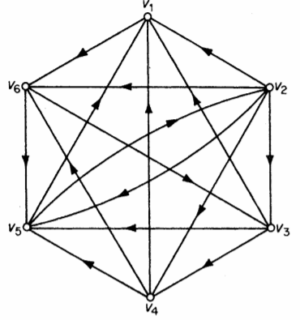
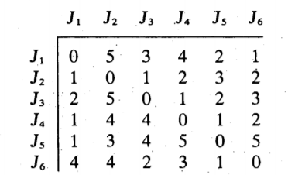
2: Graph Theory
Graphs define real world situations as a set of nodes connected relationally with a particular set of lines.
G = {V,E,W}, from J.A Bondy (1993)
V are the vertices or nodes
E are the edges or lines which connect the nodes, Adjacency
W are the weights for each edge, weighted Adjacency
G =
W=

Slide 8
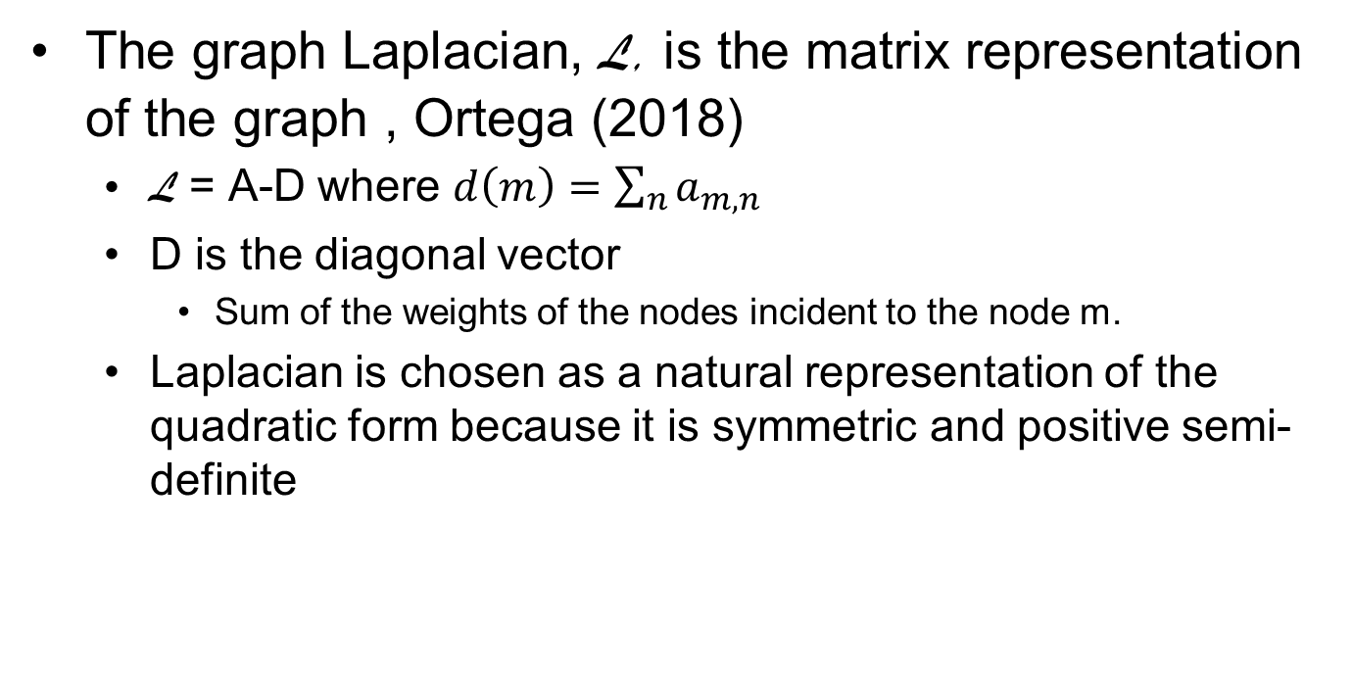
2: Graph Laplacian
The graph Laplacian, L, is the matrix representation of the graph , Ortega (2018)
L = A-D where $d\left(m\right)=\sum_{n}{a_{m,n}}$
D is the diagonal vector
Sum of the weights of the nodes incident to the node m.
Laplacian is chosen as a natural representation of the quadratic form because it is symmetric and positive semi-definite

Slide 9



2: Graph Signal Processing Ortega
GSP extends SP techniques by analyzing, interpreting, and modifying a graph signal, Ortega (2018)
A graph signal is a “signal sampled at indices represented by nodes on a graph”
GSP tools include lifted tools from SP such as Fourier analysis, wavelet analysis, neural nets, filtering, frequency response
Shift invariance
Fourier transform and wavelets transforms are lifted to GSP by incorporating the Eigen value decomposition (EVD) of the graph Laplacian into the SP tool.
Fourier Transform
Graph Laplacian
GFT: Inner Product and Conjugate Linear

Slide 10
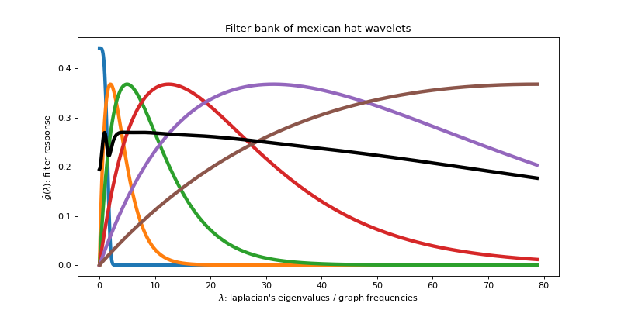




2: Spectral Graph Wavelet Transforms
Hammond (2019) presents the Spectral Graph Wavelet Transform (SGWT)
Use Eigenvalues of graph Laplacian, $λ_{L}$ to generate filters to modulate the different modes of the Fourier transform.
Different then DWT; single mother wavelet is not scaled and dilated.
Thresholding: De Loynes (2020) applies term-by-term and block thresholding for graph wavelets.
$\hat{W_{F}}\left(t,n\right)<λ=0$
Term
Block
$$\hat{W_{f}}\left(t,n\right)=B^{j}W_{f}j,(t,n)$$

Slide 11
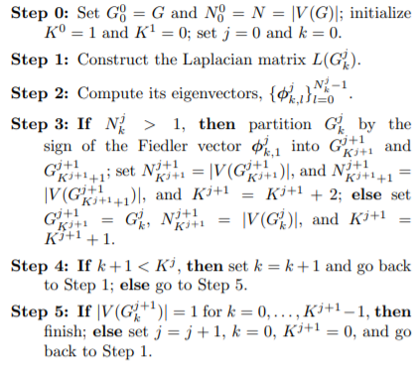
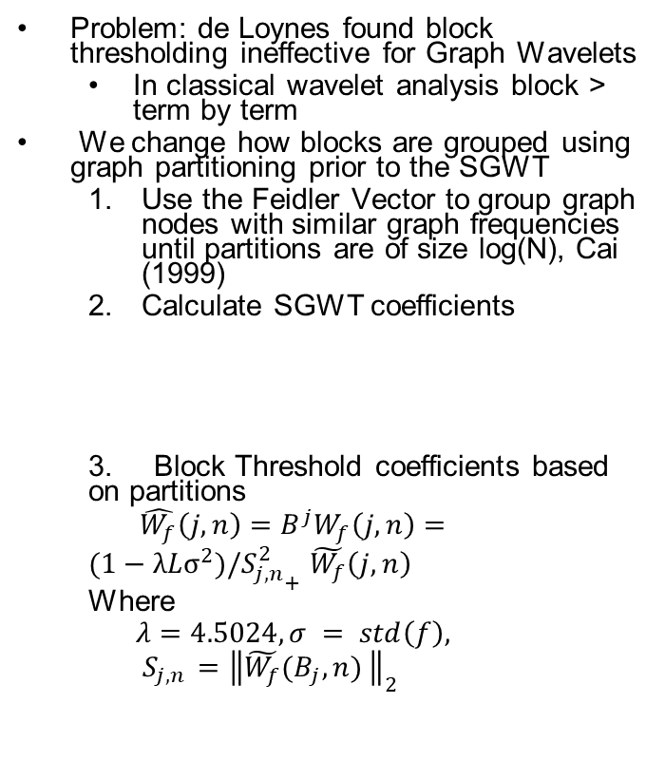
3: Block Thresholding for Wavelets on Graphs
Problem: de Loynes found block thresholding ineffective for Graph Wavelets
In classical wavelet analysis block > term by term
We change how blocks are grouped using graph partitioning prior to the SGWT
Use the Feidler Vector to group graph nodes with similar graph frequencies until partitions are of size log(N), Cai (1999)
Calculate SGWT coefficients
3. Block Threshold coefficients based on partitions
$$\hat{W_{f}}\left(j,n\right)=B^{j}W_{f}\left(j,n\right)=$$
$(1−λLσ^{2})/{S_{j,n}^{2}}_{+}$ $\tilde{W_{f}}\left(j,n\right)$
Where
$$λ=4.5024, σ = std\left(f\right), S_{j,n }={\left\|{\tilde{W_{f}}(B_{j},n)}_{ }\right\|}_{2}$$
Graph Partitioning from Saito (2014)

Slide 12
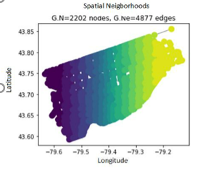
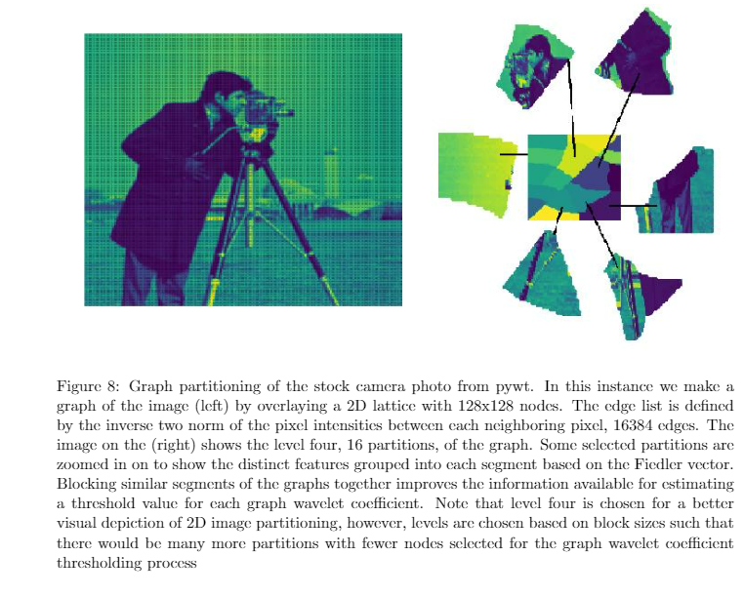
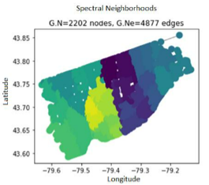
3: Block Thresholding for Wavelets on Graphs
PYWT Stock Camera
Toronto Road Network

Slide 13
Motivation for Graph Signal Processing
Technological advancements have made automatic data collection more prominent. The topography and structure of data are becoming a larger part of data analysis.
Data Topography is traditionally studied using graph theory, where the topography of data is represented as a series of nodes and edges. This is a new(ish) frontier for signal processing tools
Graph signal processing fills technical gap between signal processing and graph theory.

Slide 14
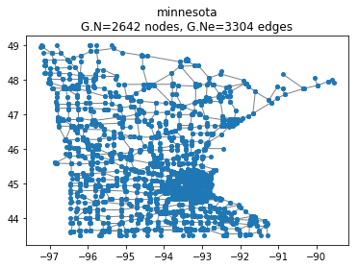
Motivation
Transportation Networks and Diffusion
Minnesota Graph
View data at each traffic intersection in Minnesota
Analyze the network the data and their interaction

Slide 15
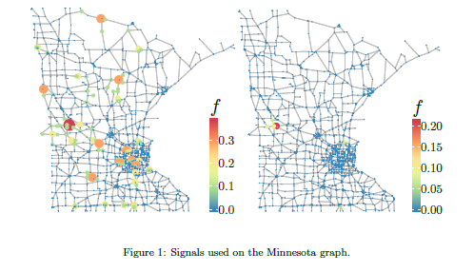

4: Minnesota Road Map: Impulse
de Loynes (2020) adds Gaussian noise to a random signal on the Minnesota Graph Network
Minnesota with Noise
Minnesota Denoised

Slide 16
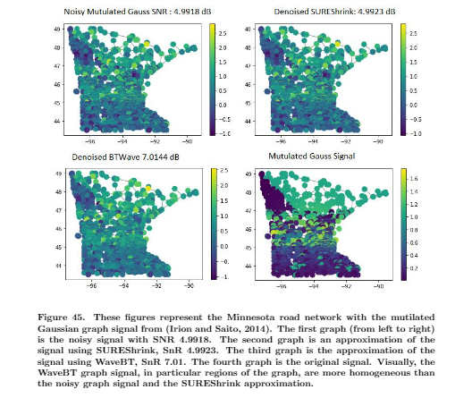
4: Minnesota Road Map: Mut Gauss

Slide 17
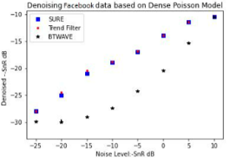
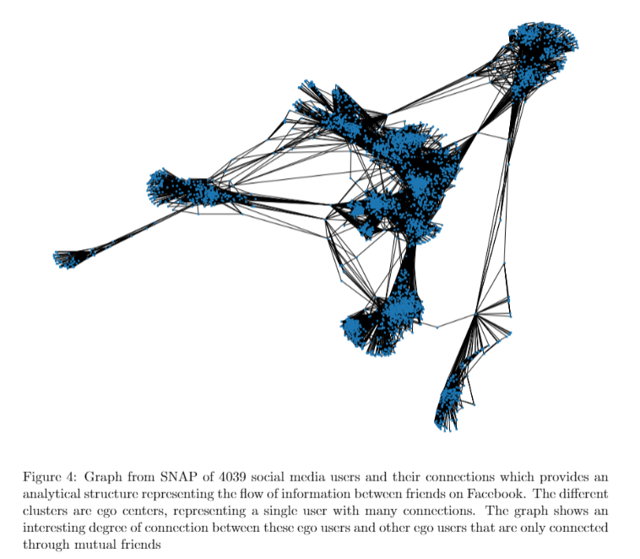
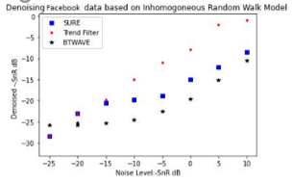
4: Social Network
Wang (2015)

Slide 18
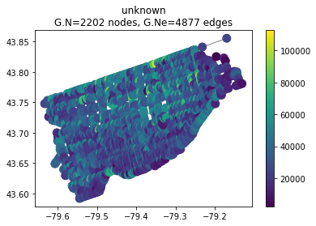
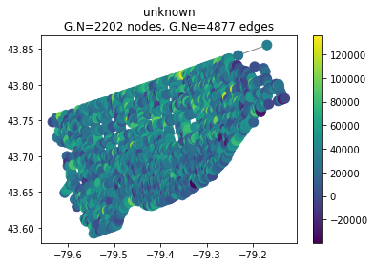
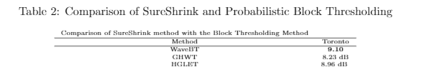
4: Toronto Road Map
Real World Traffic Data for the city of Toronto over a 24 hour perion, Irion Saito (2014)
Original Data
Noisy Data, Gauss SNR 7

Slide 19
5: Conclusion
Given GSP is the use of SP tools for signals sampled at nodes on a graph, it is intuitive that SP concepts will persist for GSP.
Wavelet transforms are effective at smoothing graph signals
Proper thresholding improves the effectiveness of wavelet transforms on graphs
Term-by-term and block thresholding are effective in wavelets for graph signals
Our contribution: Block thresholding should be defined by spectral neighborhoods defined by graph partitioning
Code and Full Paper, https://github.com/JeffreyDWilliams/GSPWaves

Slide 20
6: References
Bondy, J.A. and Murty, U.S.R., 1976. Graph theory with applications (Vol. 290). London: Macmillan.
Cai, T. T. and B. W. Silverman (2001). Incorporating information on neighbouring coefficients into wavelet estimation.The Indian Journal of Statistics B, 127–148.
Coifman, R. and M. Maggioni (2006). Diffusion wavelets.Applied and Computational Harmonic Analysis 21(1), 53–94.
Crouse, M., R. Nowak, and R. Baraniuk (1998). Wavelet-based statistical signal processing using hidden markov models.IEEE Transactions on signal processing 46(4), 886–902.
de Loynes, B., F. Navarro, and B. Olivier (2021). Data-driven thresholding in denoising with spectral graph wavelet transform.Journal of Computational and Applied Mathematics 389,113319.
Defferrard, M., X. Bresson, and P. Vandergheynst (2016). Convolutional neural networks on graphs with fast localized spectral filtering.ArXiv 1, 1.
Donoho, D. L. and I. M. Johnstone (1995). Adapting to unknown smoothness via wavelet shrinkage.Journal of the American Statistical Association 90(432), 1200–1224.
Hammond, D.K., V. P. and R. Gribonval (2011). Wavelets on graphs via spectral graph theory. Applied and Computational Harmonic Analysis 30(2), 129–150.
Irion, J. and N. Saito (2014). Wavelets on graphs via spectral graph theory. JSIAM Letters 6,21–24.
Kay, S.M., 1993. Fundamentals of statistical signal processing. Prentice Hall PTR.
Ortega, A., P. Frossard, J. Kovaevi, J. Moura, and P. Vandergheynst (2018). Graph signal processing: Overview, challenges, and applications. Proceedings of the IEEE 106(5), 808–828.
Pang, J., G. Cheung, A. Ortega, and O. Au (2015, April). Optimal graph laplacian regularization for natural image denoising. In IEEE International Conference on Acoustics, Speech and Signal Processing (ICASSP), pp. 2294–2298. IEEE.
Wang, Y., J. Sharpnack, A. Smola, and R. Tibshirani (2015, February). Trend filtering on graphs. In Artificial Intelligence and Statistics, pp. 1042–1050. PMLR.

Slide 21
References
Cai, T. T. and B. W. Silverman (2001). Incorporating information on neighbouring coefficients into wavelet estimation.The Indian Journal of Statistics B, 127–148.
Coifman, R. and M. Maggioni (2006). Diffusion wavelets.Applied and Computational Harmonic Analysis 21(1), 53–94.
Crouse, M., R. Nowak, and R. Baraniuk (1998). Wavelet-based statistical signal processing using hidden markov models.IEEE Transactions on signal processing 46(4), 886–902.
de Loynes, B., F. Navarro, and B. Olivier (2021). Data-driven thresholding in denoising with spectral graph wavelet transform.Journal of Computational and Applied Mathematics 389,113319.
Defferrard, M., X. Bresson, and P. Vandergheynst (2016). Convolutional neural networks on graphs with fast localized spectral filtering.ArXiv 1, 1.
Donoho, D. L. and I. M. Johnstone (1995). Adapting to unknown smoothness via wavelet shrinkage.Journal of the American Statistical Association 90(432), 1200–1224.
Hammond, D.K., V. P. and R. Gribonval (2011). Wavelets on graphs via spectral graph theory. Applied and Computational Harmonic Analysis 30(2), 129–150.
Irion, J. and N. Saito (2014). Wavelets on graphs via spectral graph theory. JSIAM Letters 6,21–24.
Ortega, A., P. Frossard, J. Kovaevi, J. Moura, and P. Vandergheynst (2018). Graph signal processing: Overview, challenges, and applications. Proceedings of the IEEE 106(5), 808–828.
Pang, J., G. Cheung, A. Ortega, and O. Au (2015, April). Optimal graph laplacian regularization for natural image denoising. In IEEE International Conference on Acoustics, Speech and Signal Processing (ICASSP), pp. 2294–2298. IEEE.
Wang, Y., J. Sharpnack, A. Smola, and R. Tibshirani (2015, February). Trend filtering on graphs. In Artificial Intelligence and Statistics, pp. 1042–1050. PMLR.

Slide 22
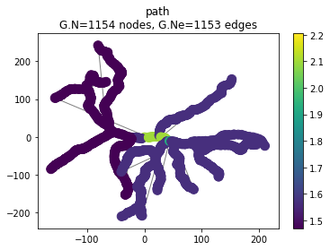
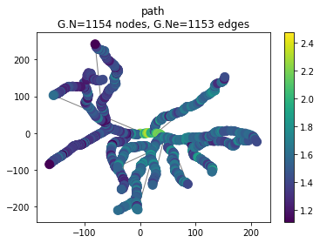
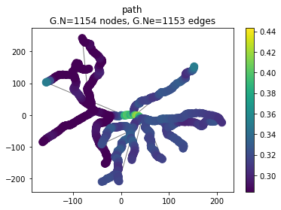
Case Study 2: Rat Ganglion Cell (IP)
(Coombs 2006) measured the widths at different areas of the mouse retinal ganglion cell
Compare Probabilistic Block Thresholding with Best Basis technique (Irion 2014)
Original
Noisy 20 dB
Denoised

Slide 23
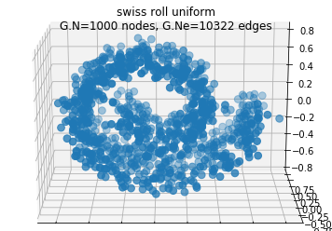
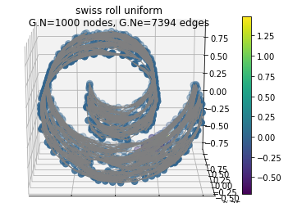
Case Study 3: Manifold Denoising
Deutsch 2016 attempt to predict a manifold from a point cloud using a SGWT prediction scheme

Slide 24
Questions?

